Slide 1
TAK Server - Docker Installation

Slide 2
TAK Server - Docker Installation
If you don’t have docker downloaded, then go to the following link and install it:
https://docs.docker.com/desktop/install/windows-install/
Once downloaded open docker and a terminal on your local machine.
Go to the following link, you don’t have an account create one:
https://registry1.dso.mil/account/sign-in?redirect_url=%2Fharbor%2Fprojects

Slide 3
TAK Server - Docker Deployment - Database
The setup for the TAK Server on Docker is a double server setup, where one server runs the database and the other runs the core.
We need to setup the database first:
Login into registry1:
docker login registry1.dso.mil
The login credentials that will need are from here: https://registry1.dso.mil/account/sign-in?redirect_url=%2Fharbor%2Fprojects
Pull the image from registry1 to the docker registry:
docker pull registry1.dso.mil/ironbank/tcp/tak/tak-server-db:5.0
Create the docker bridge network to run the TAK Server:
docker network create takserver-net-hardened

Slide 4
TAK Server - Docker Deployment - Database
Run the TAK Server DB container and connect it to the docker bridge network:
docker run -d -it -p 5432:5432 --network takserver-net-hardened --network-alias tak-database --name takserver-db-5.0 --env envpass=atakatak registry1.dso.mil/ironbank/tpc/tak/tak-server-db:5.0
To view the TAK Server database container startup log:
docker exec -it takserver-db bash -c “cd /var/lib/postgresql && tail -f logfile”

Slide 5
TAK Server - Docker Deployment - Core
Note: you should have already setup the database before continuing.
If you are not logged into the registry1 already:
docker login registry1.dso.mil
Pull the image from registry1:
docker pull registry1.dso.mil/ironbank/tpc/tak-server:5.0
You should have already setup the bridge network.

Slide 6
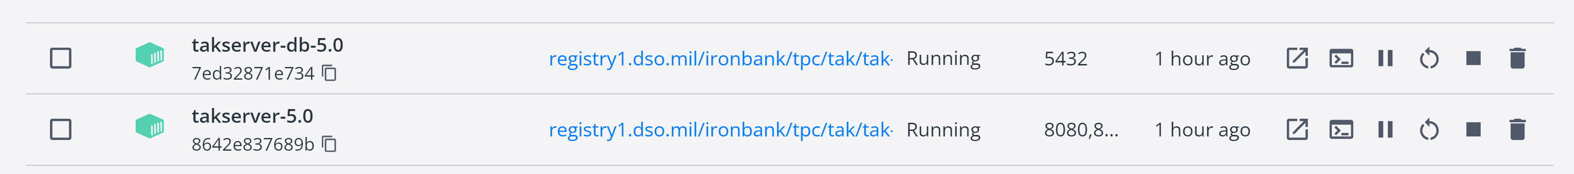
TAK Server - Docker Deployment - Core
Run the TAK Server container and connect it to the bridge network:
docker run -d -it -p 8080:8080 -p 8443:8443 -p 8444:8444 -p 8087:8087/udp -p 8088:8088 -p 9000:9000 -p 9001:9001 --network takserver-net-hardened --name takserver-5.0 --env envpass=atakatak registry1.dso.mil/ironbank/tpc/tak/tak-server:5.0
Note the we are using the network created in the database steps so that the two containers are visible to each other.
The next couple command line steps can be done from a terminal opened within the docker container.
Notes:
# If you have issues with the ports you can kill the process using the port needed or omit it from server. I had port 9000 running into issues and wasn’t able to kill it so I omitted it.
# You can see whats running on the ports by running: netstat -a -b

Slide 7

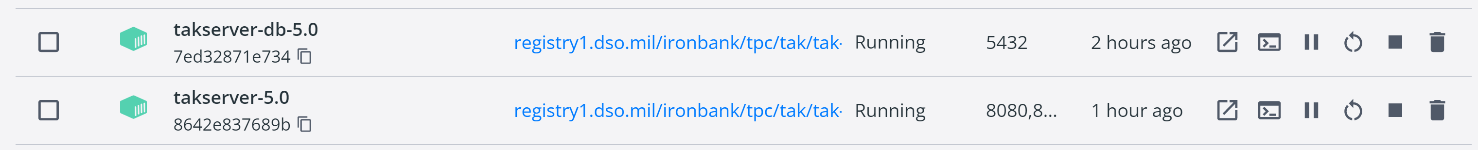
TAK Server - Docker Deployment - Core
With the terminal open in the docker container run the following:
Set the password to connect to the database:
Open the Core Config file:
vim /opt/tak/CoreConfig.xml
Set the password value to that of the “envpass” value entered when creating the container:
If you did not change it the password is: atakatak
Note: This password if for the database, if you change it in the database it needs to be update here.
Restart the docker container:

Slide 8
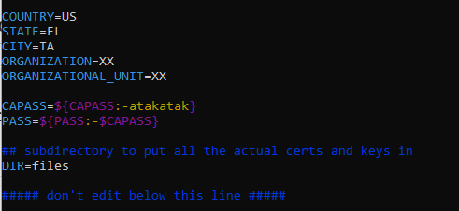
TAK Server - Docker Deployment - Core
Edit the cert-metadata.sh file:
Open the cert-metadata.sh file:
vim /opt/tak/certs/cert-metadata.sh
Change necessary values and the optional ones:
STATE: Your choice or type XX.
CITY: Your choice or type XX.
ORGANIZATION: The default is TAK unless changed.
ORGANIZATIONAL UNIT: Your choice or type XX.
Save and exit the file.

Slide 9
TAK Server - Docker Deployment - Core
Create the root certificate authority:
./makeRootCa.sh --ca-name <name for cert>
Example: ./makeRootCa.sh --ca-name TAK-ROOT-CA-01
Create the intermediate certificate authority:
./makeCert.sh ca <cert name>
Example: ./makeCert.sh ca TAK-ID-CA-01
Create the server certificate:
./makeCert.sh server <server cert name>
Example: ./makeCert.sh server takserver
Modify the Core Config file:
sed -i “s/truststore-root/truststore-<cert name>/g’ /opt/tak/CoreConfig.example.xml
Example: sed -i ‘s/truststore-root/truststore-TAK-ID-CA-01/g’ /opt/tak/CoreConfig.example.xml

Slide 10
TAK Server - Docker Deployment - Core
You can verify the changes in the Core Config file by running the following:
cat /opt/tak/CoreConfig.example.xml | grep truststore-
Restart the server container:
You can view the logs as the server starts up by running the following in a terminal in the docker container:
tail -f /opt/tak/logs/takserver-messaging.log
tail -f /opt/tak/logs/takserver-api.log
Make the administrator certificate:
./makeCert.sh client <admin name>
Example: ./makeCert.sh client webadmin

Slide 11
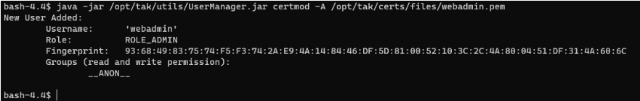
TAK Server - Docker Deployment - Core
Modify the admin certificate we just created to provide administrative access:
java -jar /opt/tak/utils/UserManager.jar -certmod -A /opt/tak/certs/files/<admin cert>.pem
Example: java -jar /opt/tak/utils/UserManager.jar -certmod -A /opt/tak/certs/files/webadmin.pem

Slide 12
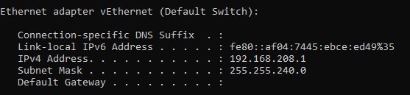
TAK Server - Docker Deployment - Admin Dashboard
To access the admin dashboard, we need to get the IP of the server and download the needed cert files:
Identify the servers IP:
On your local machine open a new terminal and type the following:
Windows: ipconfig
Linux: ifconfig
Find the output that looks similar to the following:
The IPv4 entry is the IP address.

Slide 13
TAK Server - Docker Deployment - Admin Dashboard
Before we try to open the admin dashboard, we need to get and import the admin cert we created.
Copy the admin cert to your local machine:
In a terminal on your local machine run the following:
docker cp takserver-5.0:/opt/tak/certs/files/<cert-name>.p12 .
Example: docker cp takserver-5.0:/opt/tak/certs/files/webadmin.p12 .
While on this topic it wouldn’t be a bad idea to copy over the truststore file either:
docker cp takserver-5.0:/opt/tak/certs/files/<truststore-file>.p12 .
Example: docker cp takserver-5.0:/opt/tak/certs/files/truststore-TAK-ID-CA-01.p12 .
Note in the coping of files the period at the end is imported, designating where to copy the file to. The period indicates to copy the file to the current location. You can specify the path or go to the desired path before downloading to have it download to a specific location.

Slide 14
TAK Server - Docker Deployment - Admin Dashboard
Import the admin certificate:
In your choice of web browser open its settings and search for “cert”
Navigate to the certificate manager and import the admin cert we copied over.
If you are note able to find the admin cert when searching in the File Explorer, make sure the settings for filtering are set to “All Files”.
If you import the file in Firefox, you need to do a couple more steps:
Once imported go over to the “Authorities” tab and find your certs. (Root cert and Intermediate cert)
Select them and then select “Edit Trust”
Enable “This certificate can identify websites” for both.

Slide 15
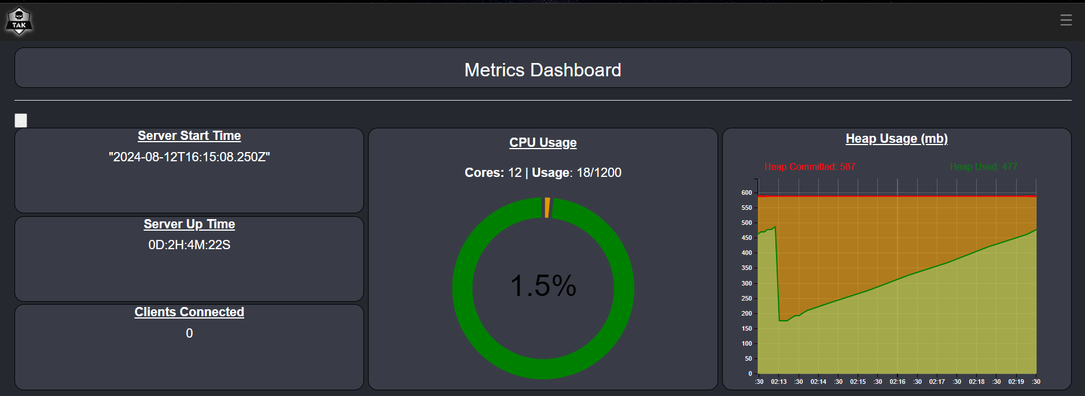
TAK Server - Docker Deployment - Admin Dashboard
To access the admin dashboard for the TAK Server:
In the web-browser you imported the certs to type the following into the:
https://<IP address>:8443
The IP address is the one that we identified earlier.
If you need to find it again, type ipconfig into a terminal to show the network configurations.

Slide 16
Resources
Database: https://ironbank.dso.mil/repomap/details;registry1Path=tpc%252Ftak%252Ftak-server-db
Core: https://repo1.dso.mil/dsop/tpc/tak/tak-server/-/blob/development/README.md?ref_type=heads
Harbor: https://registry1.dso.mil/account/sign-in?redirect_url=%2Fharbor%2Fprojects

